Slide 1
Shakin’ Hands and Living in SYN: A TCP Tale
CSE 461 Section

Slide 2

Joke Later!
Let’s learn things first!

Slide 3
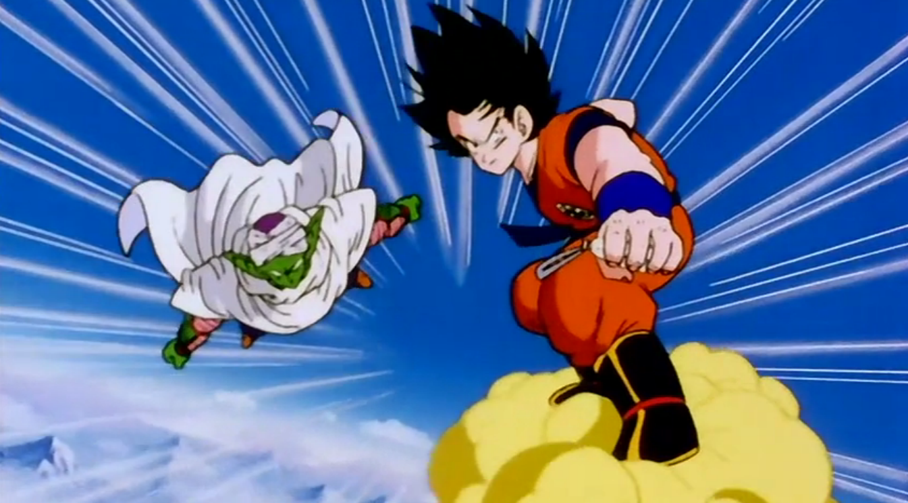
TCP Is Reliable
What do we mean by “reliable?”
  We know when the other party receives or doesn’t receive certain data
  Data arrives intact
  Data arrives in the correct order (to the application layer, at least)

Slide 4

Where This Reliability Comes From
What’s the main mechanism for ensuring this reliability?
  Sequence numbers!
  They allow packets to be identified, acknowledged, and , implicitly re-requested
  For TCP to work, clients must know each other’s sequence number schemes

Slide 5
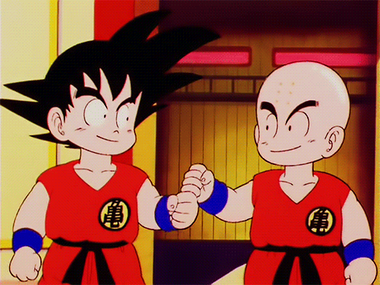
Starting Communication:
The Three-Way Handshake
Need to synchronize with each
other’s sequence numbers
How can we do this?
Active open vs. passive open
  connect() vs. listen()
SYN packet
  Send own sequence number A
SYN/ACK packet
  Acknowledge with A+1, send own sequence number B
ACK packet
  Acknowledge with B+1
Demonstration

Slide 6
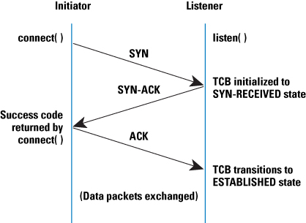
Three-Way Handshake Diagram

Slide 7

Ending Communications
We need a protocol for stopping communications
What could we do?
Let’s send packets to close
the connection!
FIN/ACK sequence

Slide 8
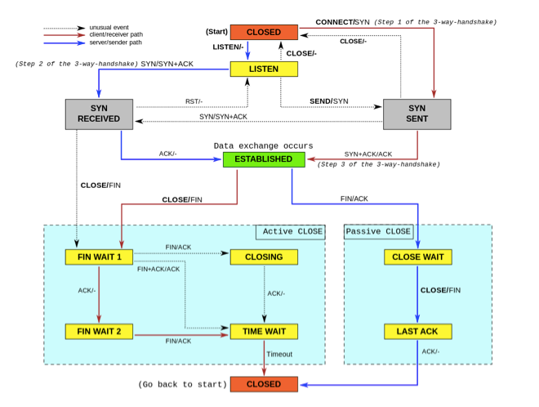
TCP FSA

Slide 9
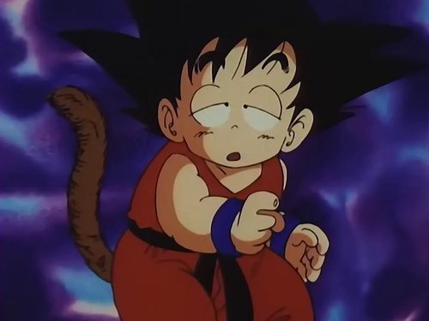
TCP Half-Open
TCP Half-Open
  One client is in the open state; the other is not
How could this happen?
  One endpoint has crashed
  One endpoint has removed the socket
  One endpoint has received a SYN and
  sent a SYN/ACK, but the other side
  has not ACKed the SYN/ACK yet
  One endpoint has sent a FIN and
  received an ACK, but the other side
  has not sent a FIN yet
  RST packet often sent in these cases

Slide 10

SYN Flooding
Hosts allocate a TCB (Transmission Control Block) on receipt of a SYN packet and put in the “SYN queue”
They then send a SYN/ACK and wait for an ACK response
However, what if one host sends lots of SYNs and no ACKs?
  Causes the receiving host to allocate lots of TCBs, filling up resources
  This attack is called “SYN flooding”

Slide 11

SYN Flooding Countermeasures
What ideas can we think of to make it so that SYN flooding doesn’t work?
  Constraint: we don’t want to break TCP!)
  Identify SYN flooders and filter their packets
  Reduce our timeout until we garbage-collect TCBs
  Recycle half-open TCP connections
  Use SYN cookies
    Sequence number encodes all of the
    data that would otherwise be stored
    This allows us to garbage-collect our
    SYN queue and still respond to
    subsequent ACKs

Slide 12

TCP Connection Hijacking
TCP is not (by default) encrypted
This means anyone sniffing our packets can see the sequence numbers being used
How is this a problem?
  For many protocols, the sequence and acknowledgement numbers are the other “security”
  Using these numbers can make a host think that you’re
  sending the next packet in a communication session
  This can cause the communication to be re-addressed
  to a new IP address/port

Slide 13

TCP Veto
In TCP, how does a server know to discard a duplicate packet? What does it check for?
  Correct checksum
  Same sequence number
How are sequence numbers generated?
  Randomly at first, then incremented
  Often, this increment is unpredictable,
  and depends on received data length
  How could we secret inject a packet
  into communication?
    Predict the length and sequence number
    of some data in the future
    Pre-empt that data with a similar packet

Slide 14

Joke Time
Two jokes

Slide 15
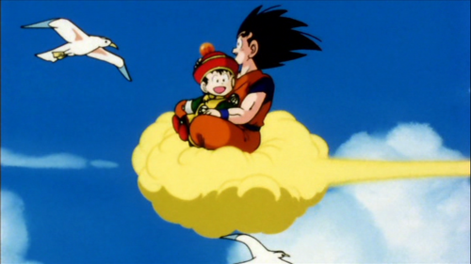
Questions?

